Slide 1
CUSTOMER CHURN PREDICTION
Mentor’s Name:
Team Members:
Kaveti Nani Kartik
BAREDDY PAVANI
MADANAPU PRATHYUSHA
Amandeep
Deepesh Kumar Verma

Slide 2
CONTENTS
Business Objective
Dataset Overview
Columns and Datatypes
Data Preprocessing
EDA
Feature Importance
SMOTE
Model Building
Challenges Faced
Deployment

Slide 3
BUSINESS OBJECTIVE
Customer churn is a major problem for telecom companies (churn >10% annually).
Objective: Predict probability of churn based on customer features.
Helps in retention strategies and reducing customer loss.

Slide 4
DATASET OVERVIEW
It contains information about customer accounts, their usage of services, and whether they ultimately churned (canceled their service).
Shape: It has 3333 rows (representing customers) and 19 columns (representing different attributes or features of the customers).
Data Quality:
There are no missing values in the dataset.
There are no duplicate rows.

Slide 5
COLUMNS AND DATA TYPES
The dataset contains the following columns, with a mix of numerical and categorical features (represented as integers):
account_length: (int64) The number of days the account has been active.
voice_mail_plan: (int64) Whether the customer has a voicemail plan (1 for yes, 0 for no).
voice_mail_messages: (int64) The number of voicemail messages.
day_mins, evening_mins, night_mins, international_mins: (float64) The total number of minutes the customer has used during the day, evening, night, and for international calls, respectively.
customer_service_calls: (int64) The number of calls made to customer service.
international_plan: (int64) Whether the customer has an international plan (1 for yes, 0 for no).
day_calls, evening_calls, night_calls, international_calls: (int64) The total number of calls made during the day, evening, night, and for international calls, respectively.
day_charge, evening_charge, night_charge, international_charge, total_charge: (float64) The charges for usage during different times of the day, for international calls, and the total charge.
churn: (int64) This is the target variable. It indicates whether the customer has churned (1 for yes, 0 for no).

Slide 6
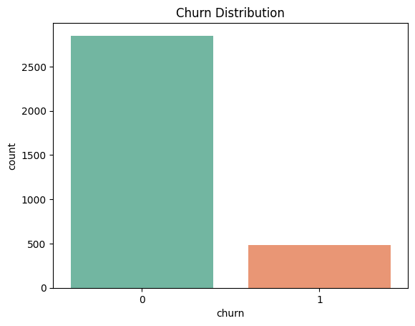
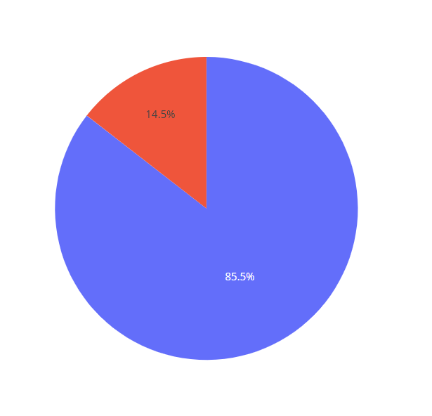
Churn Distribution
0
1

Slide 7
DATA PREPROCESSING
Data Cleaning:
  Checked for missing or null values → handled or imputed where necessary.
  Verified data types.
Encoding Categorical Data:
  Used Label Encoding / One-Hot Encoding for binary features
Feature Scaling:
  Standardized numerical features..
Feature Engineering:
  Created derived features (like total call minutes, total charges, etc., if done).
  Dropped unnecessary columns.

Slide 8
EDA
Univariate Analysis:
Checked distribution of key numerical variables (minutes, charges, etc.).
Found outliers in usage and charge-related columns.
Observed churn distribution imbalance (e.g., fewer churned customers than loyal ones).
Bivariate Analysis:
Compared churn vs. non-churn groups:
  Customers with International Plan → higher churn rate.
  Customers with more customer service calls → more likely to churn.
  High day charges and minutes correlate with churn.

Slide 9
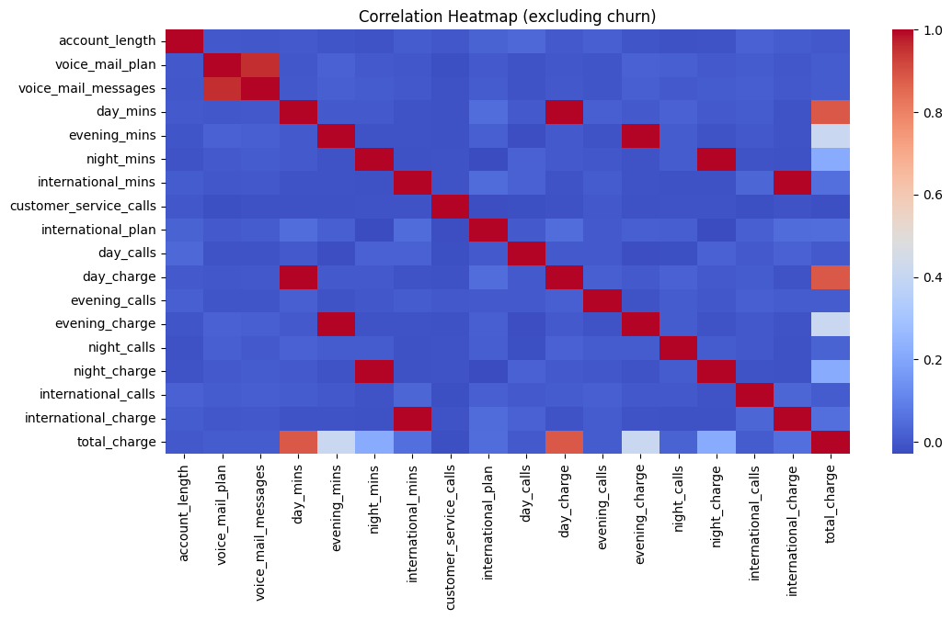

Slide 10
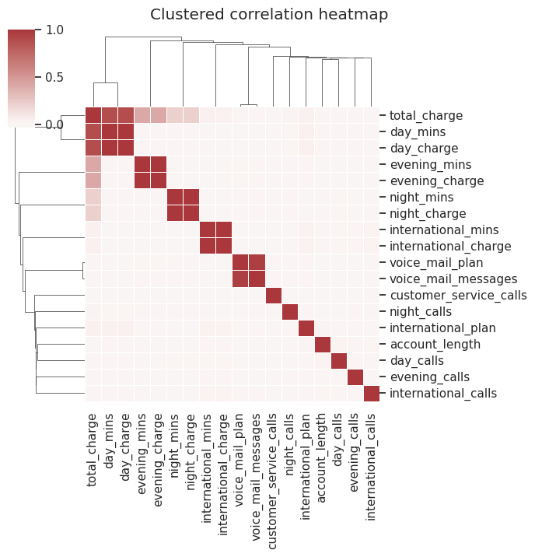

Slide 11
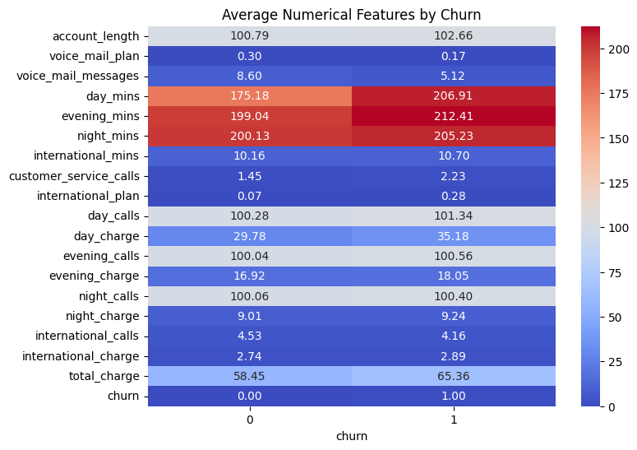
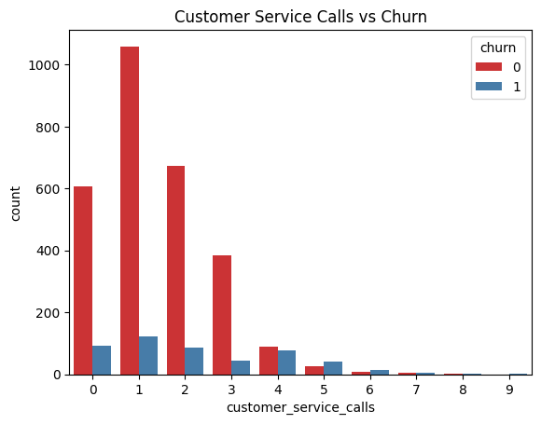

Slide 12
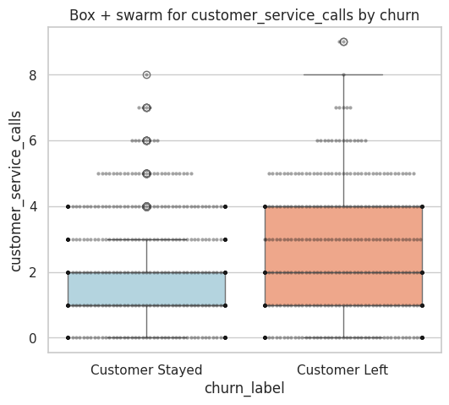
This plot shows that customers who left made more customer service calls on average compared to those who stayed.
Higher call frequency, especially with outliers, appears to be associated with churn.

Slide 13
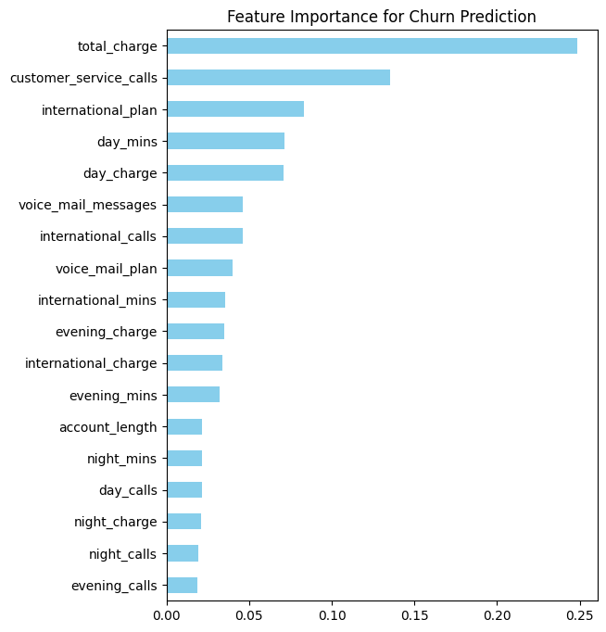
FEATURE
IMPORTANCE
Plot shows that customer_service_calls, total_charge, and international_plan have the strongest impact on churn predictions.
High values of these features generally push the model towards predicting churn.

Slide 14
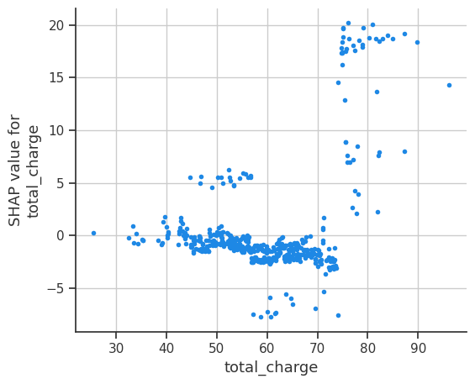
This SHAP (Shapley Additive exPlanations) dependence plot shows how the feature total_charge influences the model’s output.
At higher total charges (around 70+), the SHAP values rise sharply, indicating a strong positive contribution to predicting churn.

Slide 15
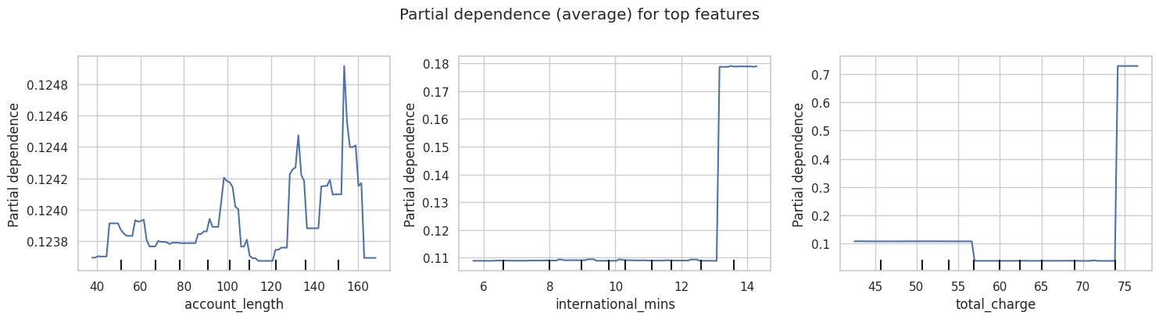
This partial dependence plot shows how account_length, international_mins, and total_charge affect churn probability on average.
The model is especially sensitive to higher values of international minutes and total charge, which sharply increase churn risk.

Slide 16
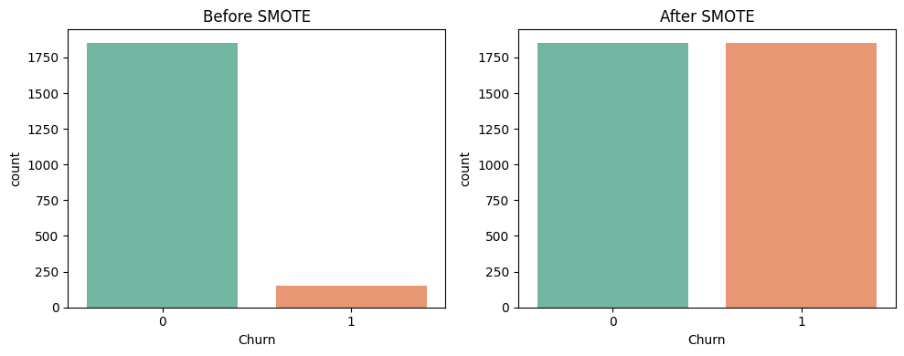
SMOTE TECHNIQUE
Before Applying SMOTE | After Applying SMOTE
0=1853 | 0=1853
1=152 | 1=1853

Slide 17
MODEL BUILDING
MODELS | ACCURACY
Random Forest | 0.972112
Tuned Random Forest | 0.972112
LightGBM | 0.972112
Tuned LightGBM | 0.972112
XGBoost | 0.970120
Tuned XGBoost | 0.970120
SVM | 0.930279
Tuned KNN | 0.876494
KNN | 0.876494
Logistic Regression | 0.778884
Tuned Logistic Regression | 0.776892

Slide 18
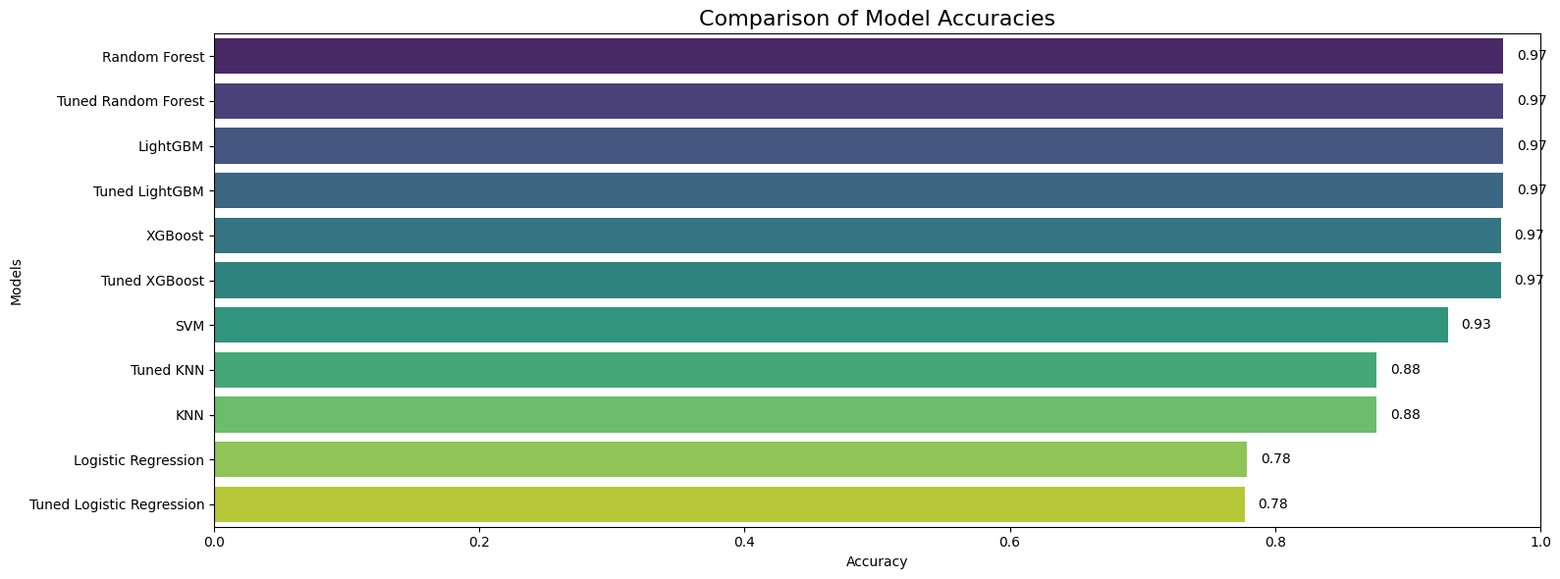

Slide 19
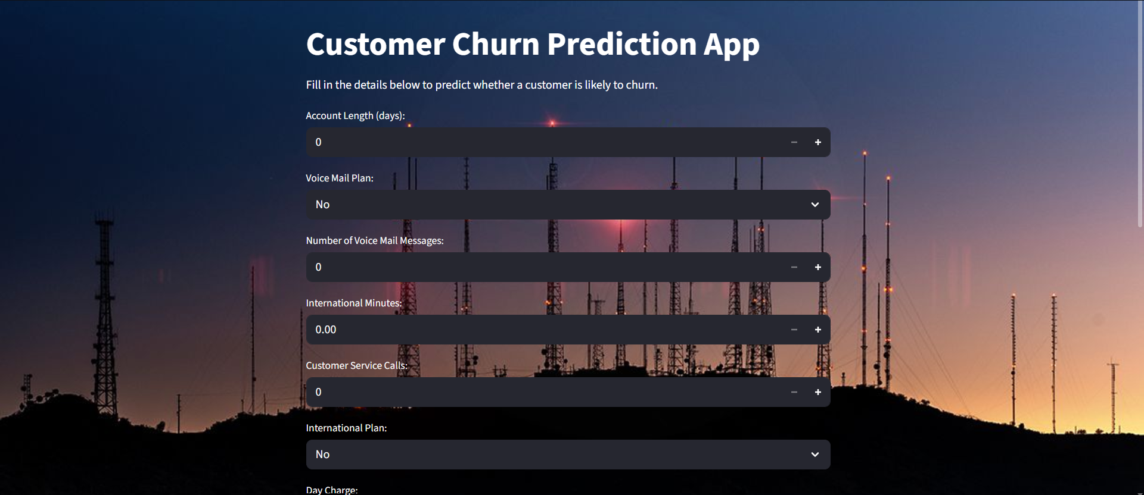
DEPLOYMENT

Slide 20
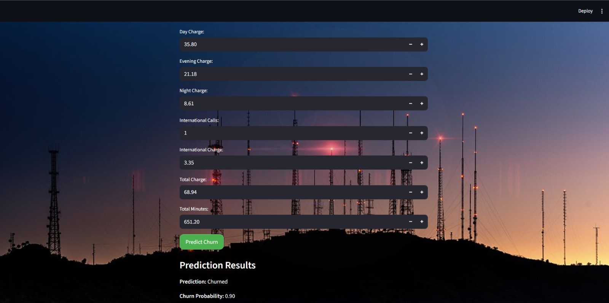

Slide 21
CHALLENGES FACED
Handling the Imbalanced dataset
Dealing with Multicollinearity
Model Selection and Hyperparameter Tuning
Avoiding the Data Leakage During Preprocessing

Slide 22
THANK YOU

